Slide 1
Wireframes Minecraft Guide
By CALIENDO François

Slide 2
Summary Page

Slide 3

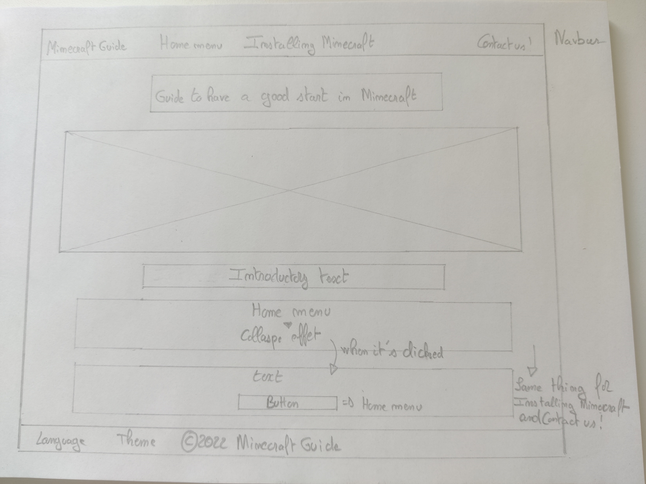


Slide 4
Home Menu

Slide 5
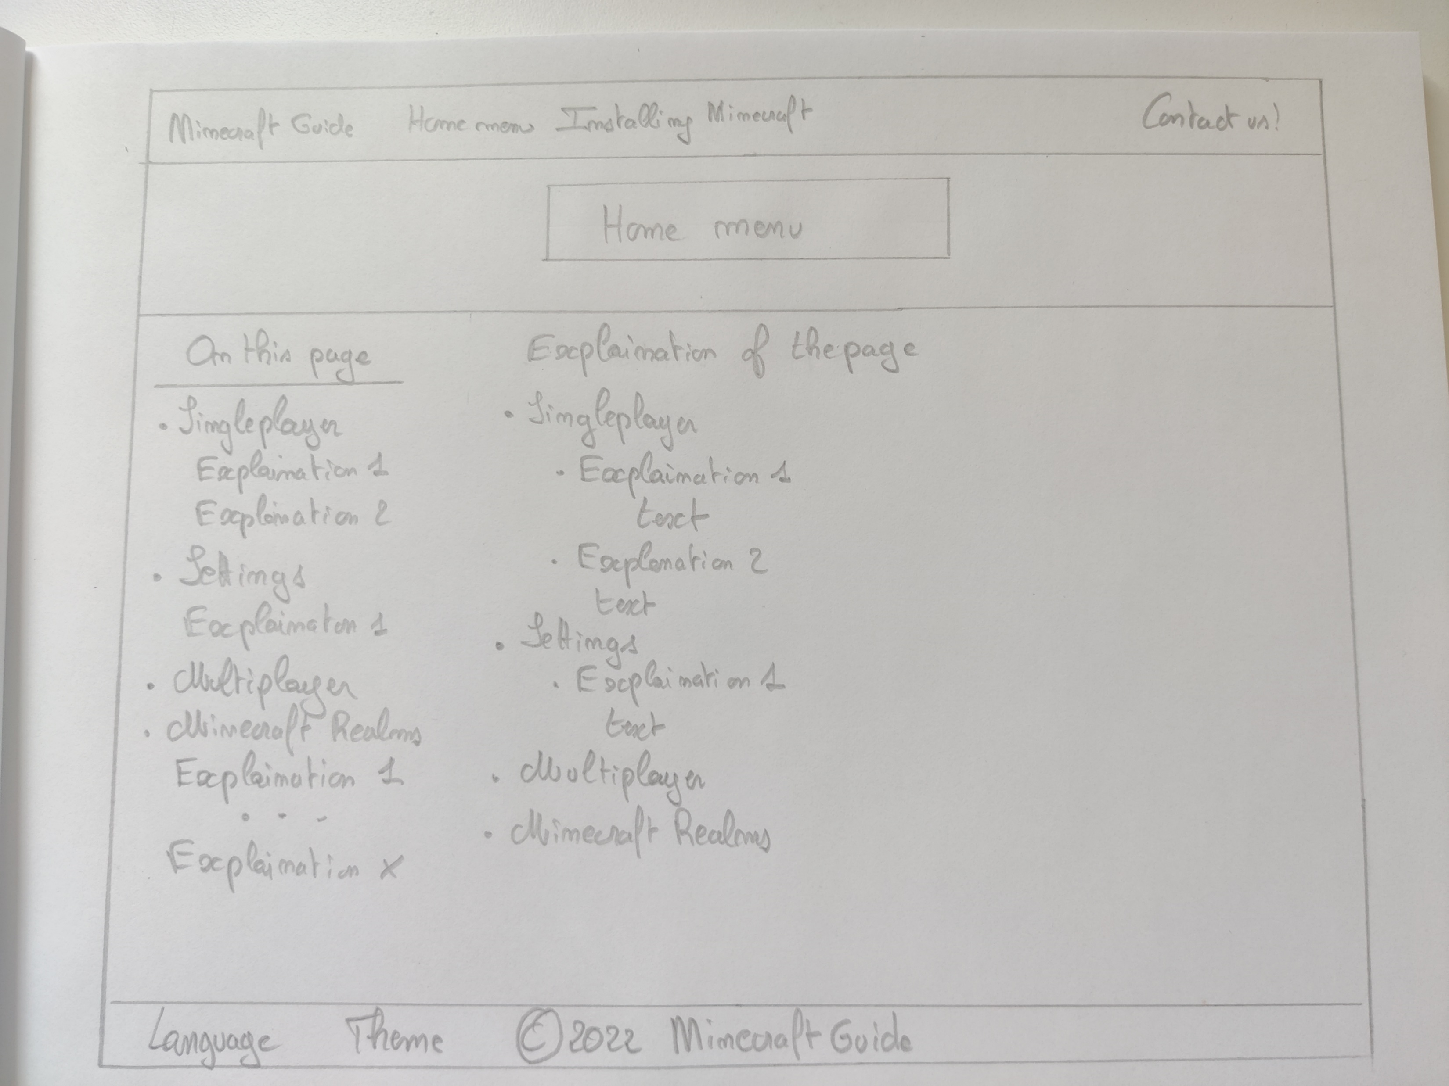

Slide 6
Installing Minecraft

Slide 7
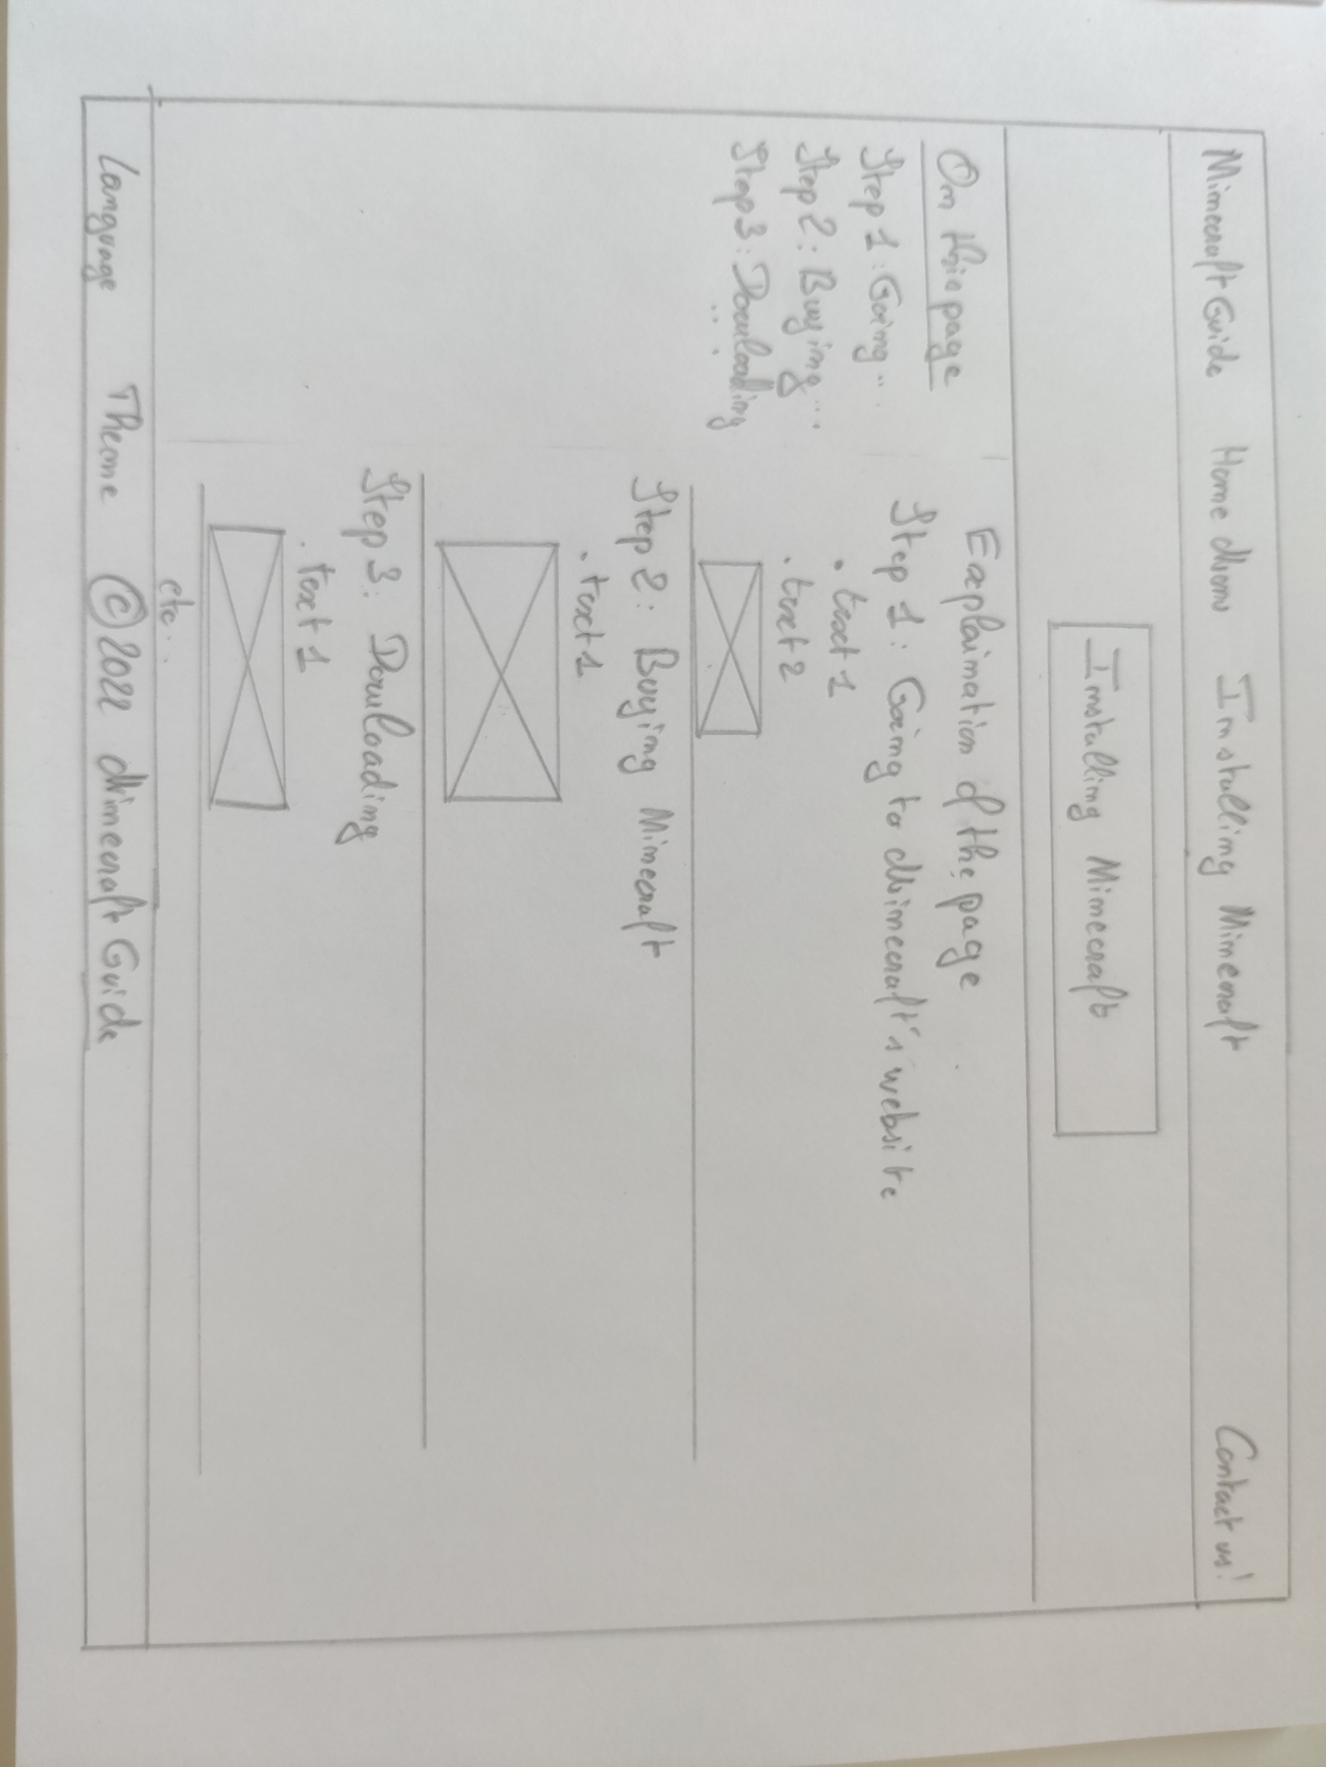

Slide 8
Contact Page

Slide 9
